Slide 1

Student-centred learning and teaching: the Essentials
LOTUS project final conference: Leadership and Organisation for Teaching and Learning at European Universities
28-29 September 2022, Brussels, Belgium
Dr Manja Klemenčič, Harvard University (and University of Ljubljana, Slovenia)
manjaklemencic@g.harvard.edu
https://scholar.harvard.edu/manja_klemencic/home

Slide 2
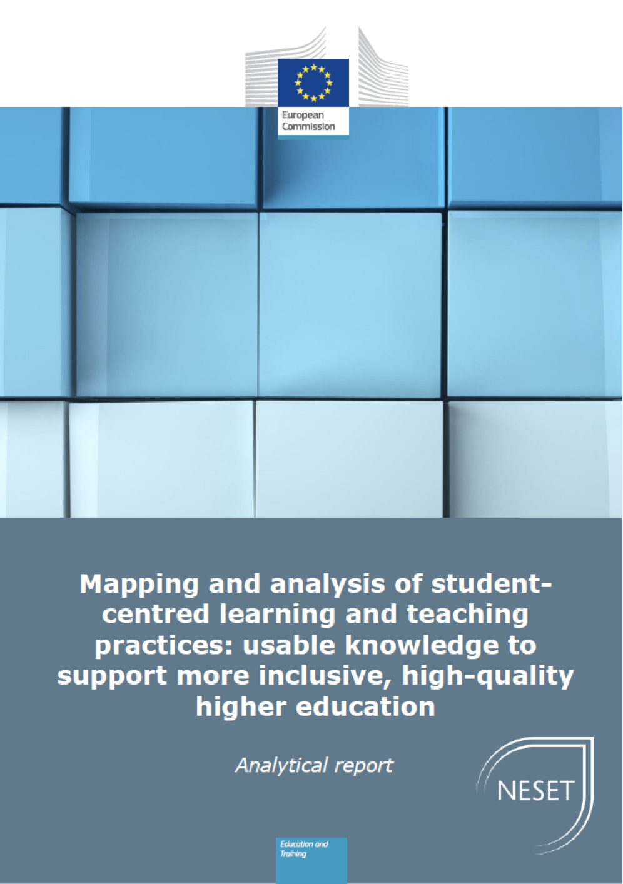
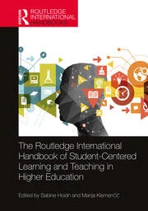
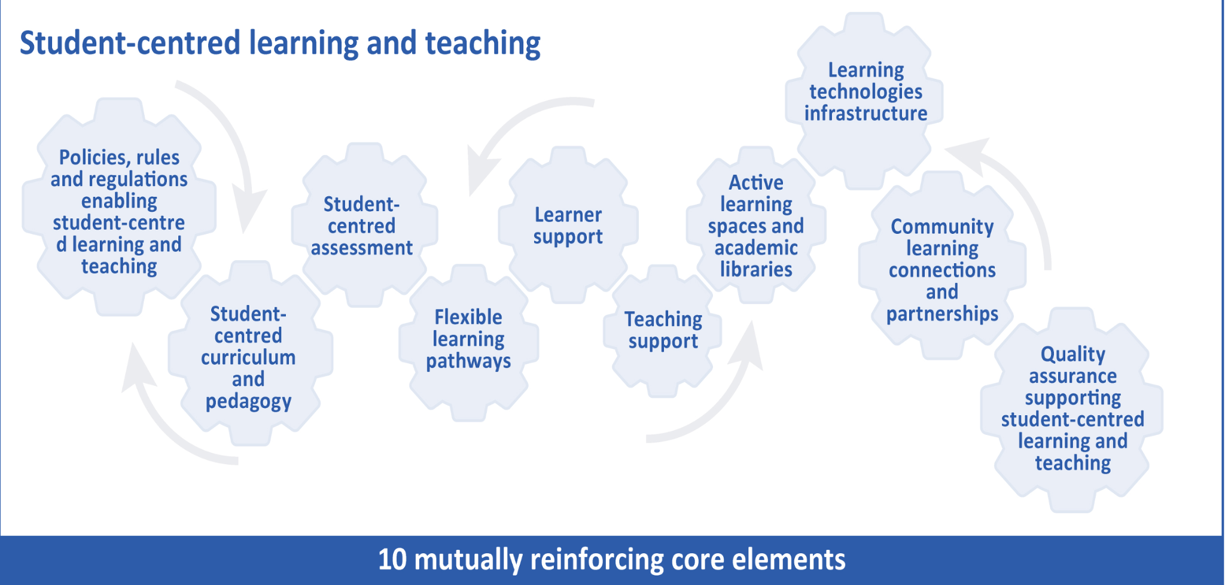
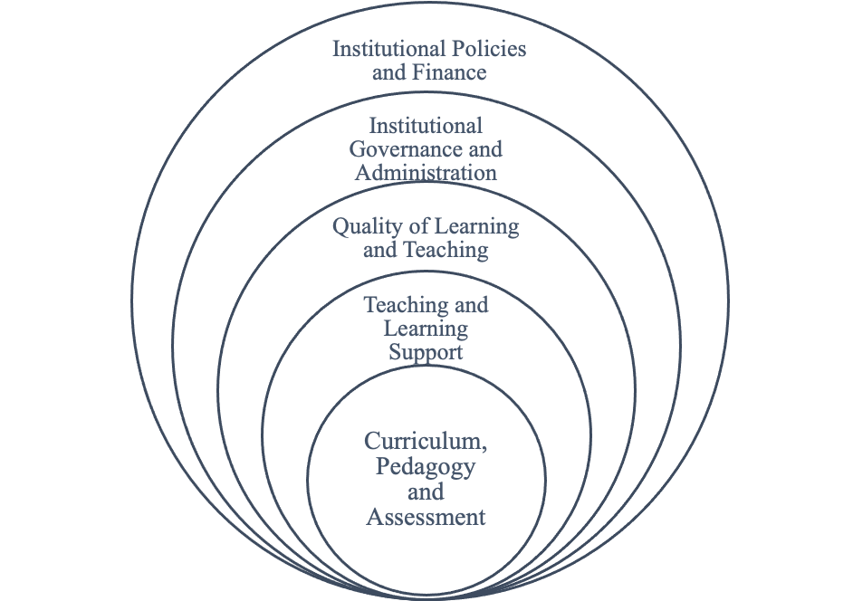

Propositions 1 SCLT does not happen only in the classroom.
A shift to SCLT requires development of a student-centred institutional ecosystem (embedded in national and European student-centred ecosystems)

Slide 3
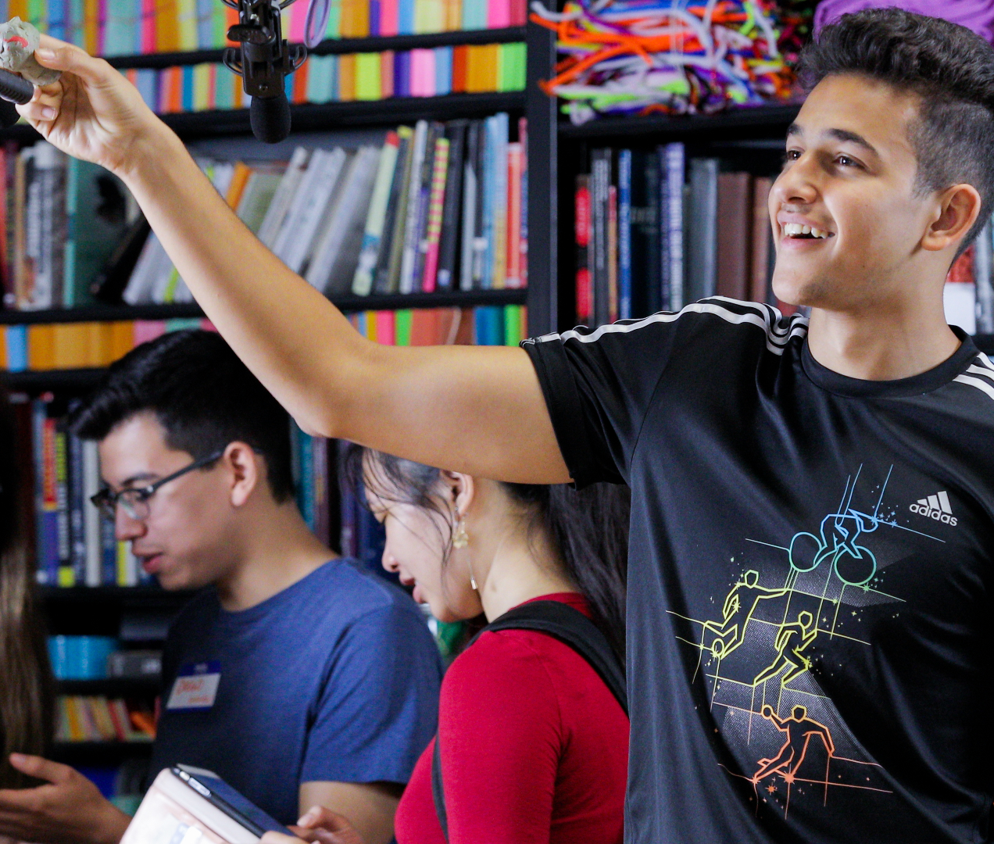

Propositions 2 SCLT implies strengthening student agency
Student agency refers to students’ capabilities to navigate, influence and take responsibility for their learning and education pathways and the student centred learning ecosystems in order to have transformative learning experiences and thus achieve learning outcomes.
Student agency implies:
Students’ self-direction and self-regulation (e.g., developing study skills and learning strategies)
Students-as-partners in learning and teaching processes, design of the curriculum

Slide 4


Propositions 3
Student-centred teaching involves:
Rethinking the use of content-heavy lectures and insert active learning activities (e.g., think-pair-share, debate, minute paper, small groups, concept map, polling, mini-quiz, presentations, etc.)
Being grounded in disciplinary and subject-specific knowledge practices: helping students to become insiders in the discipline/trade they are educated in (model knowledge/trade expert practices of disciplinary thinking, inquiry and knowledge production, and practicing in the discipline/trade)
Connect course contents with students’ lived experiences and real-world applications - challenge-based, problem-based, research-based, service/work-based approaches (to the extent possible)
Develop learning outcomes which reflect gradual progression towards the upper level of Bloom’s taxonomy of learning objectives (e.g., apply, analyse, evaluate, create)
Lead students from more directed instruction in foundational courses towards more independent learning and independent knowledge construction (e.g., inserting a degree of flexibility in course/study programme approach)
Enabling collaborative, peer-to-peer learning

Slide 5
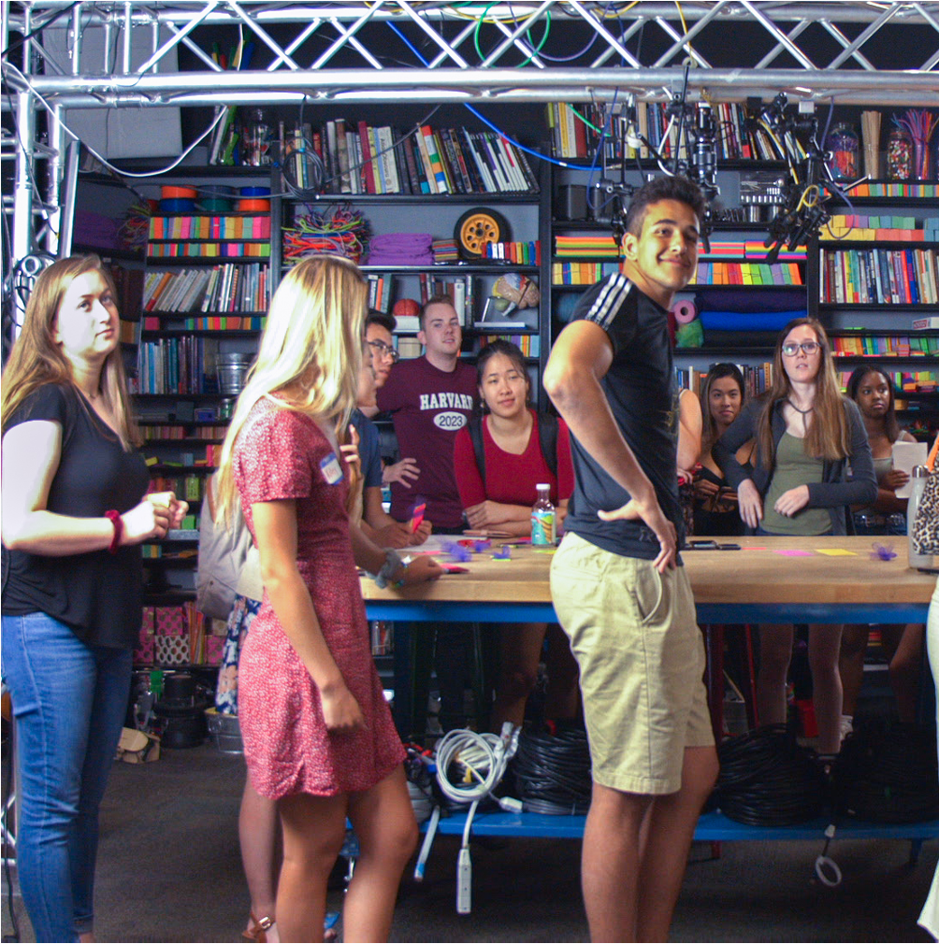

Sources
Klemenčič, M., M. Pupinis and G. Kirdulytė (2020) Mapping and analysis of student-centred learning and teaching practices: Usable knowledge to support a more inclusive high-quality higher education. Luxembourg: Publications Office of the European Union
Hoid, S. and M. Klemenčič (2020) Hoidn (2020) in Routledge Handbook on Student Centred Learning and teaching in Higher Education (Routledge, 2020).
Klemenčič, M. (2020) Students as Actors and Agents in Student-Centered Higher Education. In Sabine Hoidn and Manja Klemenčič (eds.) Routledge International Handbook on Student-Centered Learning and Teaching in Higher Education (Routledge)
Klemenčič, M. & S. Hoidn (2020) Beyond Student-Centered Classrooms: A Comprehensive Approach to Student-Centered Learning and Teaching Through Student-Centered Ecosystems Framework. In Sabine Hoidn and Klemenčič, M. (eds.) Routledge International Handbook on Student-Centered Learning and Teaching in Higher Education (Routledge)
Klemenčič, M. (2020) Successful Design of Student-Centered Learning and Teaching (SCLT) Ecosystems in the European Higher Education Area. In Bologna Process Beyond 2020: Fundamental Values of the EHEA - Proceedings of the 1999-2019 Bologna Process Anniversary Conference, Bologna, June 24-25, 2019, edited by Sijbolt Noorda, Peter Scott and Martina Vukasovic. Bologna, Italy: Banonia University Press. pp. 43-60
Klemenčič, M. (2018) The student voice in quality assessment and improvement. In Ellen Hazelkorn, Hamish Coates and Alex McCormick (eds.) Research Handbook on Quality, Performance and Accountability in Higher Education, pp. 332-343 (Edward Elgar Publishing)
Klemenčič, M. (2017) Internationalisation of Higher Education in the Peripheries: The ‘gear effect’ of integrated international engagements. In Hans de Wit, Jocelyne Gacel-Ávila, Elspeth Jones, Nico Jooste (Eds.) The Globalization of Internationalization: Emerging Voices and perspectives (Chapter 9, pp. 99-109). London: Routledge
Klemenčič, M. (2015) Student involvement in quality enhancement. In Jeroen Huisman, Harry de Boer, David Dill and Manuel Souto-Otero (eds.) The Handbook of Higher Education Policy and Governance, pp. 526-543 (Palgrave Macmillan)
Klemenčič, M. (forthcoming) Theory of student agency in higher education. In Research Handbook on Student Experiences in Higher Education.

